Slide 1
Local and remote code development with VS Code
HPC Tips & Tricks – fall 2022

Slide 2

¿questions?

Slide 3
terminology
local refers to your desktop/laptop to which you have physical access
VS Code installed
your favourite Python versions (pyenv)
your favourite C++/Fortran compilers
remote refers to a distant machine which you can access through the network using ssh
typically a login node of a HPC cluster (VSC or other)
pre-instaled software usually accessible through a module system

Slide 4
Topics covered
VS Code for
Python
C++
works also for Fortran
local and remote development
example: the Collatz conjecture
from simple Python
to vectorized C++, with a Python wrapper
debugging locally and remotely from within VS Code
debugging binary extensions
managing Python projects with micc2
create a project
version control
add binary extensions in C++ or Fortran
transfer the project to another location
cluster
other cluster
other machine

Slide 5
VS Code : “Free. Built on open source. Runs everywhere.”
= Visual Studio Code
“Visual Studio Code is a lightweight but powerful source code editor which runs on your desktop and is available for Windows, macOS and Linux. It comes with built-in support for JavaScript, TypeScript and Node.js and has a rich ecosystem of extensions for other languages (such as C++, C#, Java, Python, PHP, Go) …”
also support for Fortran
VS Code is free for private or commercial use
source code is open (https://github.com/microsoft/vscode) - so you can build it yourself if you want
download binary from https://code.visualstudio.com/ (this comes with different licence, see issue#60 for details)
“leaves more complex workflows to fuller featured IDEs, such as Visual Studio IDE”
lots of extensions from Microsoft and the community.

Slide 6
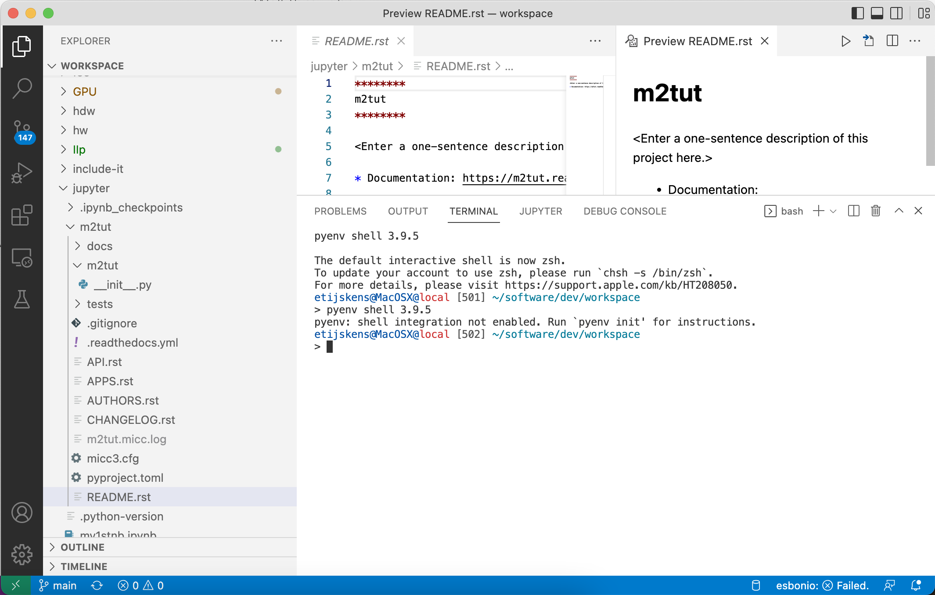
VS Code : Interface: activity bar

Slide 7
VS Code : Interface: side bar (cfr selected activity)

Slide 8
VS Code : Interface: editor/preview panel

Slide 9
VS Code : Interface: run/debug/output panel

Slide 10
VS Code : Interface: status bar

Slide 11
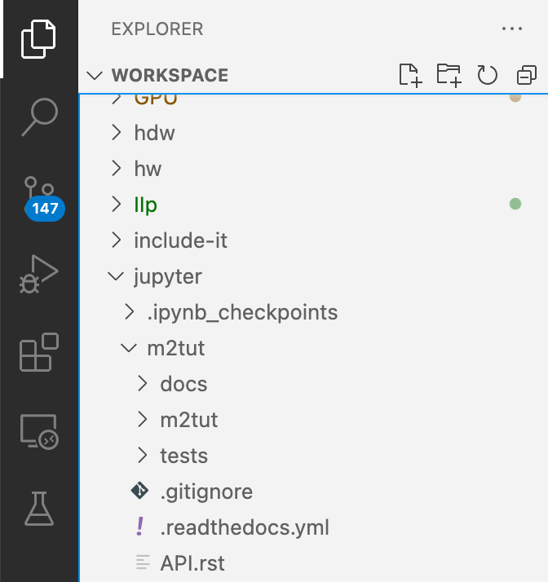
VS Code : activity bar
EXPLORER – tree view of your workspace

Slide 12
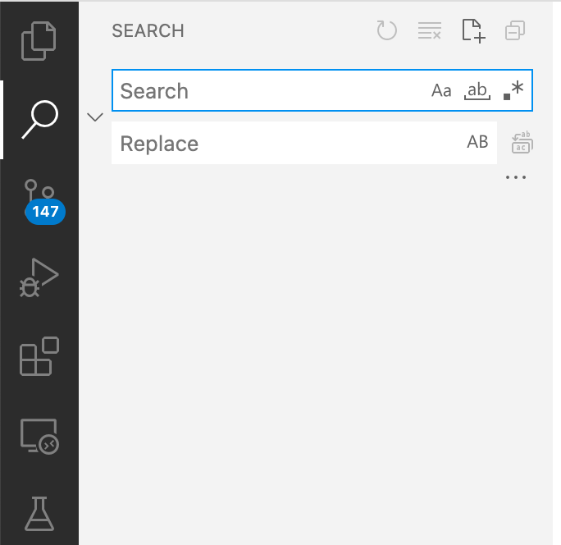
VS Code : interface
SEARCH – and replace

Slide 13
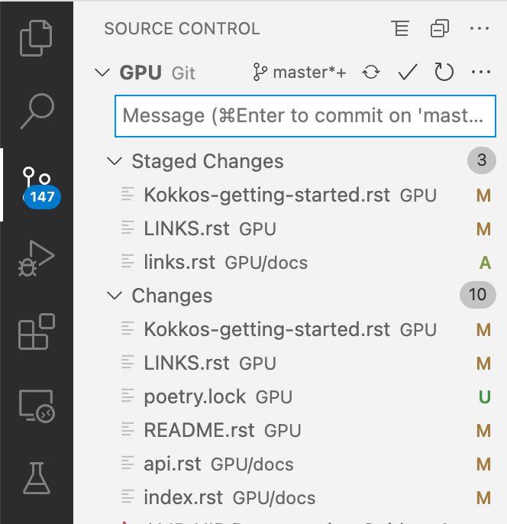
VS Code : interface
SOURCE CONTROL – embedded git

Slide 14
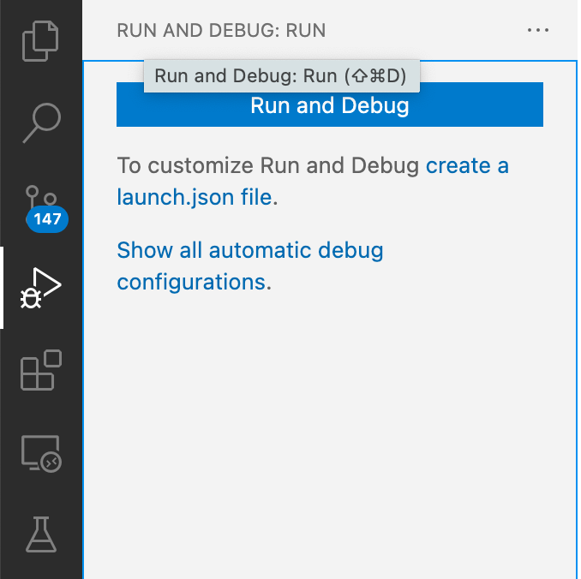
VS Code : interface
RUN AND DEBUG – configurations

Slide 15
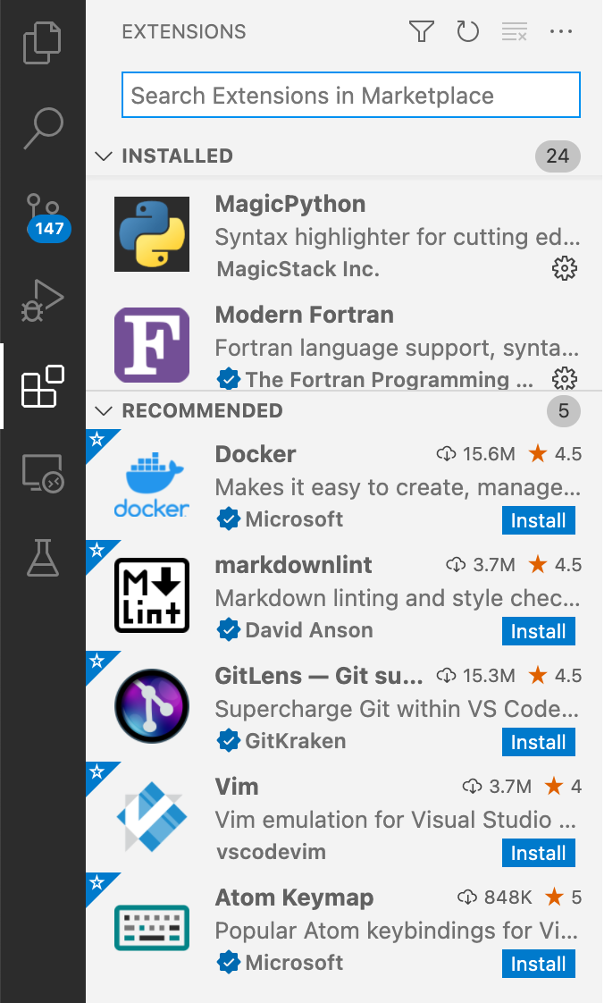
VS Code : interface
EXTENSIONS – market place

Slide 16
VS Code : interface
Marketplace – recommended extenstions
Remote Development (indispensable)
Python extension for Visual Studio Code
Python extension pack
C/C++
Better C++ syntax
Cmake
CMake tools
Modern Fortran

Slide 17
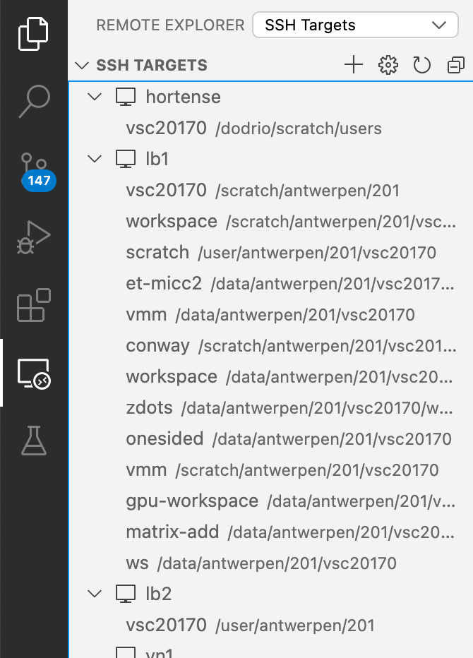
VS Code : interface
REMOTE EXPLORER – remote workspaces

Slide 18
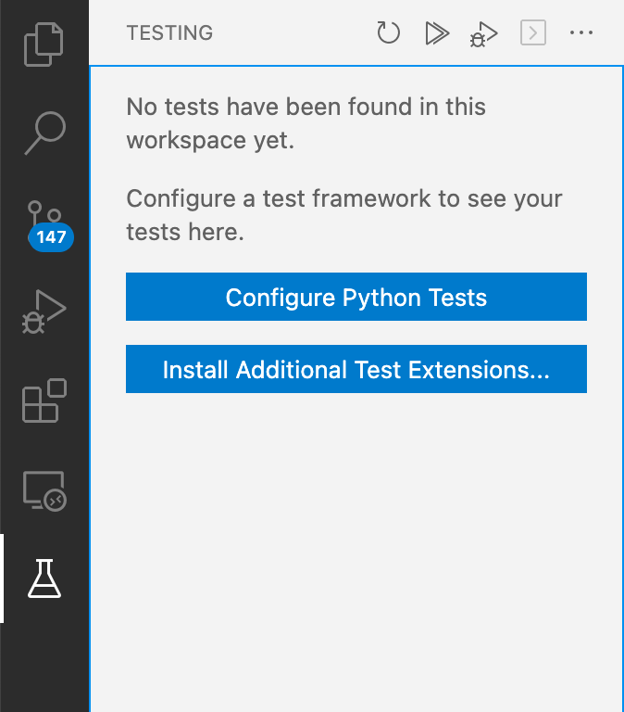
VS Code
TESTING – functionality for tests

Slide 19
Tutorial – the Collatz conjecture
This tutorial applies the research software development strategy as explained in Scientific Python
We start our development efforts locally, and transfer the code to a VSC cluster when we think it is ready for it
This is a choice. You could as well start on the cluster right away.
some tasks may be easier locally than remotely: debugging, testing various python environments, …
you can continue your work without being connected
development tools may be harder to setup (esp. on Windows)
less parallel resources

Slide 20
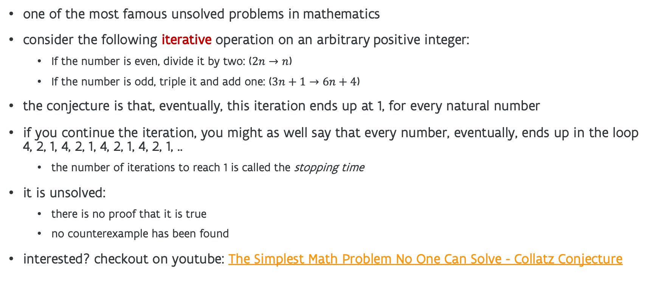
Tutorial – the Collatz conjecture
one of the most famous unsolved problems in mathematics
consider the following iterative operation on an arbitrary positive integer:
If the number is even, divide it by two: ($2n→n$)
If the number is odd, triple it and add one: ($3n+1→6n+4$)
the conjecture is that, eventually, this iteration ends up at 1, for every natural number
if you continue the iteration, you might as well say that every number, eventually, ends up in the loop 4, 2, 1, 4, 2, 1, 4, 2, 1, 4, 2, 1, ..
the number of iterations to reach 1 is called the stopping time
it is unsolved:
there is no proof that it is true
no counterexample has been found
interested? checkout on youtube: The Simplest Math Problem No One Can Solve - Collatz Conjecture

Slide 21
Tutorial – the Collatz conjecture
let’s be optimistic and try to find a counterexample
after all the iteration is extremely simple, so we can make it very fast
this has of course been tried before: all numbers up to 2⁶⁸ comply
so, our attempt is useless, but it makes a nice programming exercise

Slide 22
Tools I (love to) use: Python, C++, Fortran, micc2
let’s start out with a simple Python approach that we can gradually improve
obviously, Python isn’t really reputed for performance, but we’ll play some nice tricks to improve the performance
on the other hand Python provides a really nice programming experience and a far better development efficiency than low level languages as C/C++/Fortran
I like to start programming on my laptop (so I don’t need internet when working) and transfer the solution to one of the VSC-clusters when it is reasonably ready
I use this workflow all the time:
start with a simple Python code, and improve performance until happy with it (perhaps even throwing in C++ or Fortran code)
initiate work on laptop and move to cluster when ready (sometimes switching back and forth for trying out new ideas)
Here’s a tool that facilitates this workflow: micc2, (see its tutorial section)
I use VS Code for local and remote editing, debugging and running
check out https://github.com/etijskens/IIp for a full description of how to set up the local and remote environment for repeating the examples presented

Slide 23
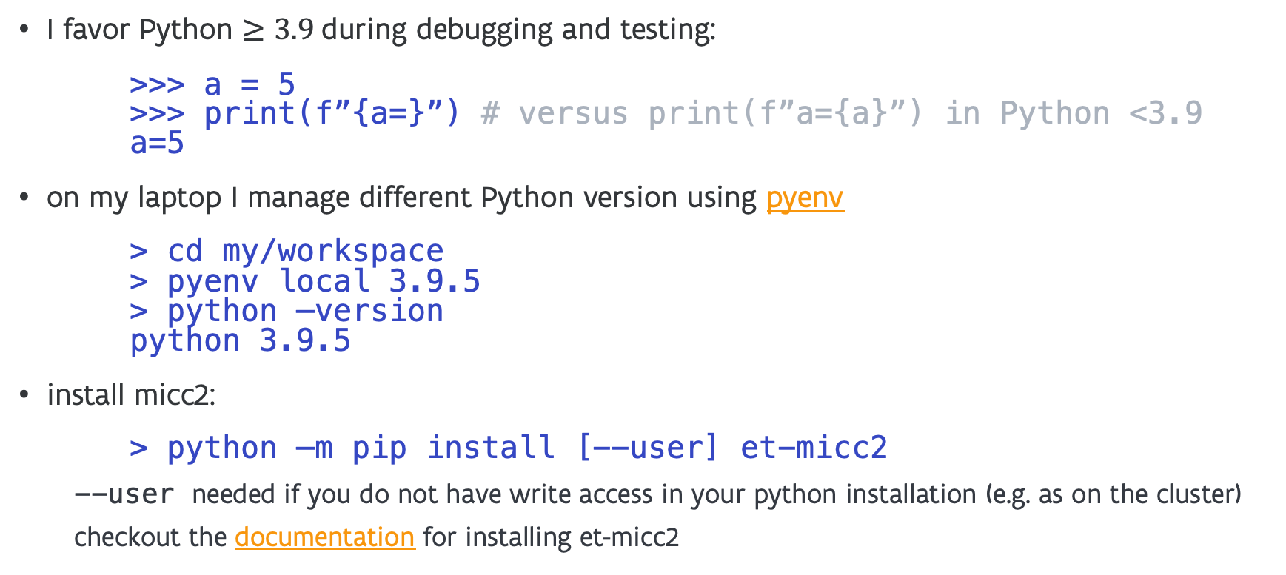
Tools I (love to) use : Python, pyenv, micc2
I favor Python $≥3.9$during debugging and testing:
>>> a = 5 >>> print(f”{a=}”) # versus print(f”a={a}”) in Python <3.9 a=5
on my laptop I manage different Python version using pyenv
> cd my/workspace > pyenv local 3.9.5 > python –version python 3.9.5
install micc2:
> python –m pip install [--user] et-micc2
--user needed if you do not have write access in your python installation (e.g. as on the cluster)
checkout the documentation for installing et-micc2

Slide 24
Tools I (love to) use: Python, micc2
create a Python project with micc2:
> micc2 create tnt-collatz [INFO] [ Creating project directory (tnt-collatz): [INFO] Python top-level package (tnt_collatz): [INFO] [ Creating local git repository [INFO] ] done. [INFO] [ Creating remote git repository at git://github.com/etijskens/tnt-collatz [INFO] ] done. [INFO] ] done. > cd tnt-collatz >
add --remote private if you don’t want your remote repo to be public
add --remote none if you don’t want a remote repo at all

Slide 25
Tools I (love to) use
> micc2 info Project tnt-collatz located at /Users/etijskens/software/dev/workspace/tnt-collatz
package: tnt_collatz version: 0.0.0 contents: tnt_collatz top-level package (source in tnt_collatz/__init__.py) >

Slide 26
what micc2 does for you
> tree . -a
.
├── .git
│ └── ...
├── .gitignore
├── .readthedocs.yml
├── API.rst ]
├── APPS.rst ]
├── AUTHORS.rst ]
├── CHANGELOG.rst ]
├── README.rst ]
├── docs ]
│ └── ... ]
├── micc3.cfg
├── pyproject.toml
├── tests
│ ├── __init__.py
│ └── tnt_collatz
│ └── test_tnt_collatz.py
├── tnt-collatz.micc.log
└── tnt_collatz
└── __init__.py
local git repo, (remote at github.com as well)
ready for publishing documentation on readthedocs
entries for adding documentation
documentation is generated with sphinx/reStructuredText documentation with MkDocs/markdown is work in progress
check out the micc2 documentation on readthedocs
ready for publishing on the Python Package Index (PyPI)
entries for (unit) tests (pytest)
entry for your python module

Slide 27
simple Python implementation
type annotations
def stoppingTime(n: int) -> int:
"""Get the stopping time of n.
Perform Collatz iteration on n until n=1, return #iterations.
"""
stopping_time: int = 0
while n > 1:
if n % 2 == 0: # n even
n /= 2
else: # n odd
n = 3 * n + 1
stopping_time += 1
return stopping_time

Slide 28
simple Python implementation
for n in range(1, 11):
print(f’{n} -> {stoppingTime(n)}’)
1 -> 0
2 -> 1
3 -> 7
4 -> 2
5 -> 5
6 -> 8
7 -> 16
8 -> 3
9 -> 19
10 -> 6

Slide 29
Tools I love to use: pytest: a unit test
# file tnt-collatz/tests/tnt_collatz/test_tnt_collatz.py
def test_stoppingTime():
"""Test for tnt_collatz.stoppingTime()."""
n = list(range(1,11))
n_expected = [ 0, 1, 7, 2, 5, 8, 16, 3, 19, 6 ]
for i in range(10):
assert tnt_collatz.stoppingTime(n[i]) == n_expected[i]
> pytest tests
=============================== test session starts ===============================
platform darwin -- Python 3.8.5, pytest-6.2.2, py-1.11.0, pluggy-0.13.1
rootdir: /Users/etijskens/software/dev/workspace/tnt-collatz
collected 1 item
tests/tnt_collatz/test_tnt_collatz.py . [100%]
================================ 1 passed in 0.11s ================================

Slide 30
speeding up (1)
import numba
@numba.jit
def stoppingTime(n: int) -> int:
"""Get the stopping time of n.
Perform Collatz iteration on n until n=1, return #iterations.
"""
stopping_time: int = 0
while n > 1:
if n % 2 == 0: # n even
n /= 2
else: # n odd
n = 3 * n + 1
stopping_time += 1
return stopping_time
@numba.jit decorator converts python code to C code and compiles it just in time
profits from the type annotations

Slide 31
speeding up (1) : timings
from et_stopwatch import Stopwatch
from tnt_collatz import stoppingTime
import numba
stoppingTimeJit = numba.jit(stoppingTime) # same as decorator, but undecorated
# stoppingTime remains accessible
N = 100_000 # number of values
n0 = 2*N+10 # starting value
print(f"range: [{n0}, {n0+N}[") #> range: [200010, 300010[
with Stopwatch():
for n in range(n0,n0 + N):
stoppingTime(n) #> 3.86 s
# move the jit compilation out of the timing loop
with Stopwatch():
stoppingTimeJit(1) #> ~15 s
with Stopwatch():
for n in range(n0,n0 + N):
st = tnt_collatz.stoppingTime(n)
#> 0.27 s, x14.5
important speed up: x14.5
easy to achieve (most of the time)
speed up comes from avoiding slow python iteration

Slide 32
speeding up
14.5 times faster is good, but can we do better?
function call overhead?
SIMD vectorisation?
add C++ binary extension to tnt_collatz module
> micc2 add simd --cpp
[INFO] [ Adding cpp submodule simd to package tnt_collatz.
[INFO] - C++ source in ../tnt-collatz/tnt_collatz/simd/simd.cpp.
[INFO] - build settings in ../tnt-collatz/tnt_collatz/simd/CMakeLists.txt.
[INFO] - module documentation in ../tnt-collatz/tnt_collatz/simd/simd.rst (restructuredText format).
[INFO] - Python test code in ./tnt-collatz/tests/tnt_collatz/simd/test_simd.py.
[INFO] ] done.
new entries for
C++ source code
build settings
documentation
test code

Slide 33
C++ SIMD version of stoppingTime
create a work array with the size W of a vector register Python ints are 64bit, so we can treat 4 ints at a time (W=4)
fill the work array with W values
perform 1 collatz iteration on these 4
if any of the values is 1, store its stopping time, replace it with the next value in the list and go back to 2 if the list is exhausted finish the remaining elements in the work array and exit
building the module is as simple as `micc2 build`
the loop is auto-vectorized by the compiler (-O3)
check the details of the code in the github repo

Slide 34
C++ simd version of stoppingTime
Timings (on a compute node of Leibniz):
stoppingTime 3.87s
stoppingTimeJit 0.267s x14.48
stoppingTimeSimd 0.0171s x15.62 x226
SIMD version development is more complicated, but (at least) in this case, worth the effort, (since we want to test all positive 64-bit integers)

Slide 35
Reasons to add a C++ binary extension
low-level control, squeeze out every bit of performance you can
Complex tasks which are slow in Python for which numba gives little improvement
tasks which need to link with other C/C++/Fortran libraries for which a Python API is lacking
tasks for which you would like to use C++ data structures which have no Python equivalent (or slow)
multi-core tasks (e.g. OpenMP)
Python (still) suffers from the Global Interpreter Lock GIL but C++/Fortran libraries can perfectly run multi-threaded code
...
micc2 allows you to combine the best of two worlds with ease
development and user experience of Python
speed of low-level languages as C++ and Fortran

Slide 36
don’t throw away the original Python version
Use it to validate the improvements in unit tests
verify that tnt_collatz.simd.stoppingTime and == tnt_collatz.stoppingTime have the same outcome

Slide 37



transferring your project to another (remote) machine
git clone
git commit
git push
git pull
git commit
remote
my-project/.git
local
my-project/.git
github.com/
userid/my-project.git
remote
git pull
git push
remote
my-project/.git
From the git perspective, the repositories on the local machine and on the remote machine are all local repositories and the repository on github.com is the remote repository.
remote
my-project/.git
You can have as many local repositories as you want.

Slide 38
transferring your project to another (remote) machine
say, your local work is finished and you want to try it out on the cluster (Leibniz, Vaughan, Hortense, …)
open terminal:
> git status
(to see which files have been modified and or changed)
> git add <newfile>`
(to stage the new files)
> git commit –a –m ”some informing commit message”`
(to commit the changes to your local repo)
> git push
(to push your local commits to the remote github repo)

Slide 39
transferring your project to another (remote) machine
open a remote terminal (ssh, or inside VS Code):
> git clone https://github.com/<github_userid>/<repo_name>
> cd <repo_name>
continue your project work on the remote …
You can switch back and forth between various machines/clusters.
save your work to the GitHub repo (git status / git add / git commit / git push)
first time on machine clone the GitHub repo (git clone)
next time on machine pull the GitHub repo to get the changes you pushed on other machines (git pull)
advice: learn how to use git
Every time you push, your work is backed up!

Slide 40
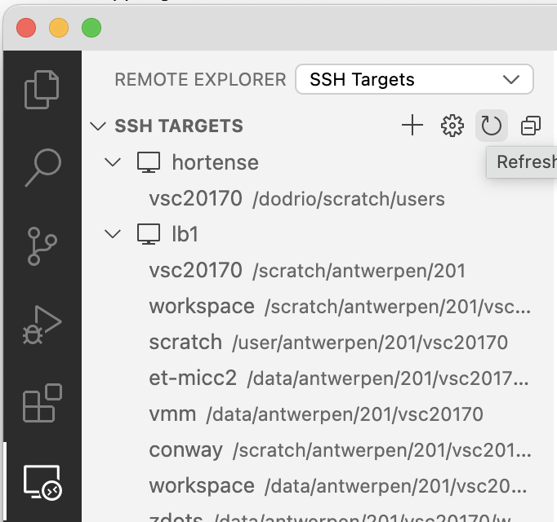
VS Code for remote work
Open the remote explorer
click + next to SSH TARGETS

Slide 41
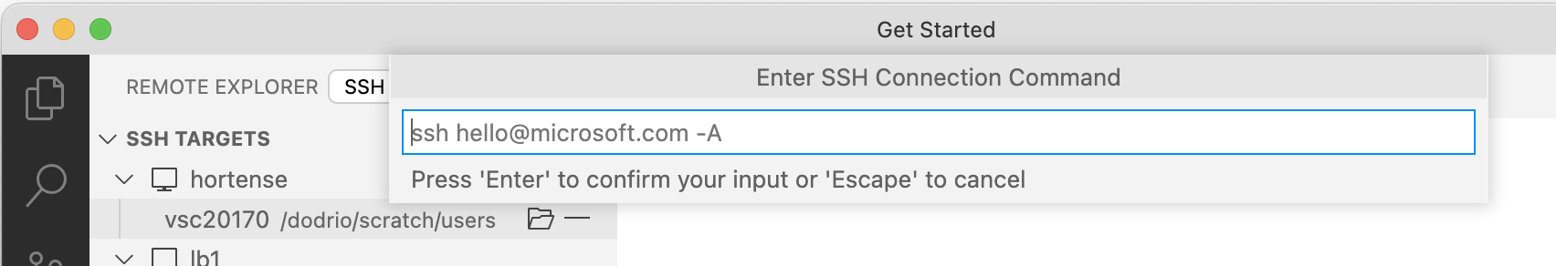
VS Code for remote work
enter the command you would normally use to access the cluster from a terminal, e.g. to access Leibniz:
> ssh vsc20170@login1-leibniz.hpc.uantwerpen.be

Slide 42
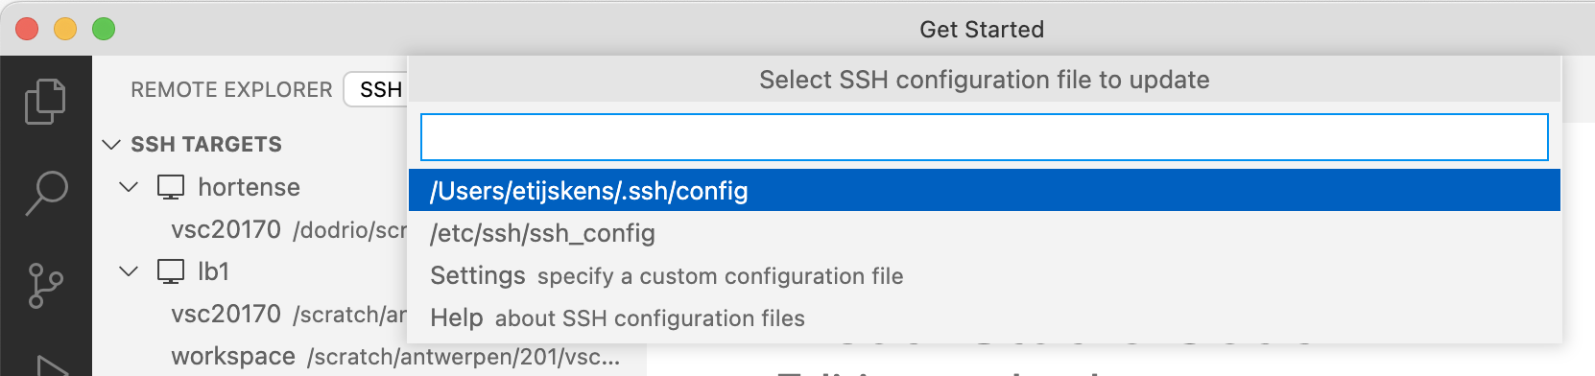
VS Code for remote work
select the usual .ssh/config file:

Slide 43
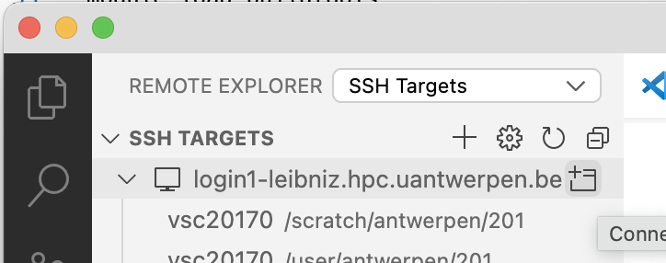
VS Code for remote work
connect to host in new window

Slide 44
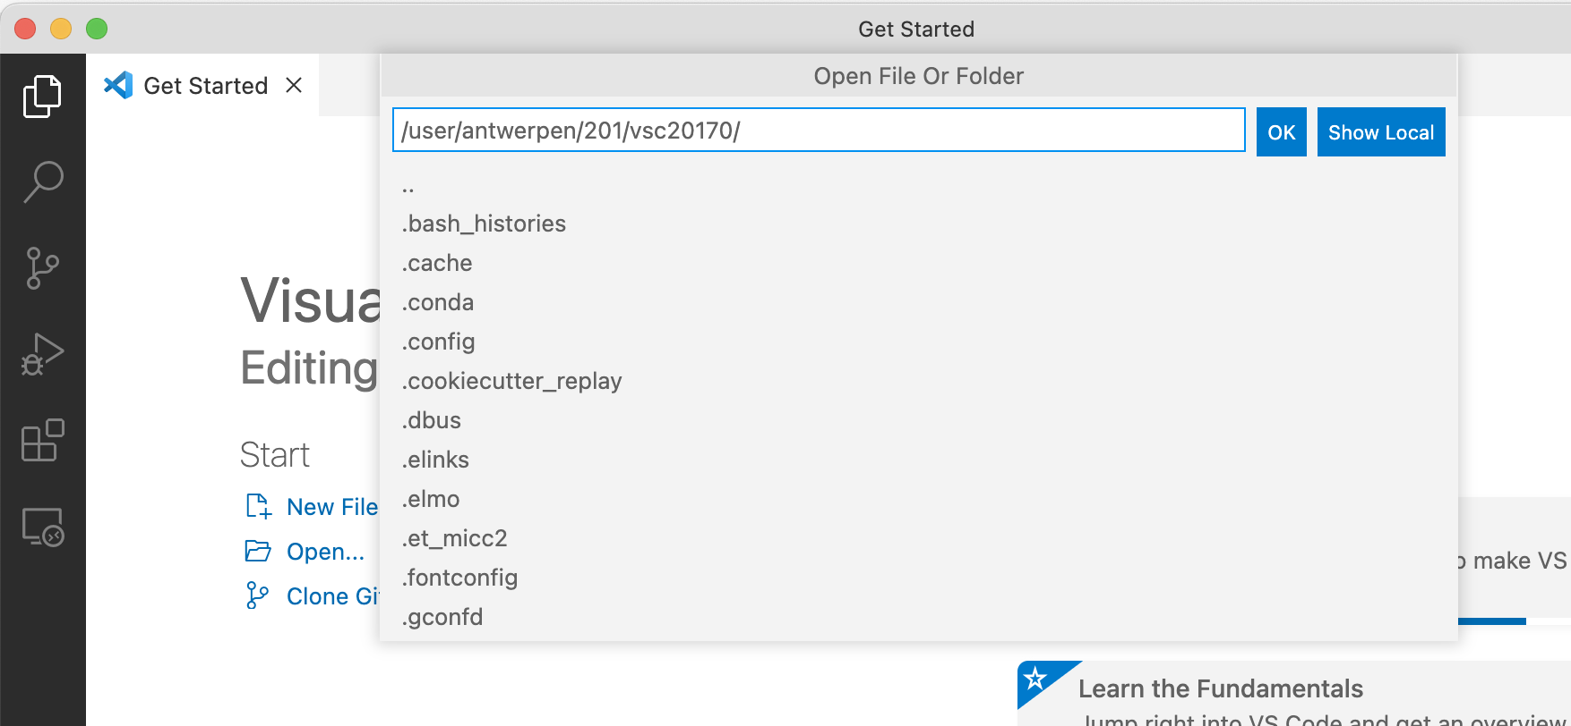
VS Code for remote work
click Open… and enter the path to your workspace folder
do NOT use the default
/user/antwerpen/…
it is too small
instead use
/data/antwerpen/…
not small and backed up
or
/scratch/antwerpen/…
fast, not small, but no backup

Slide 45
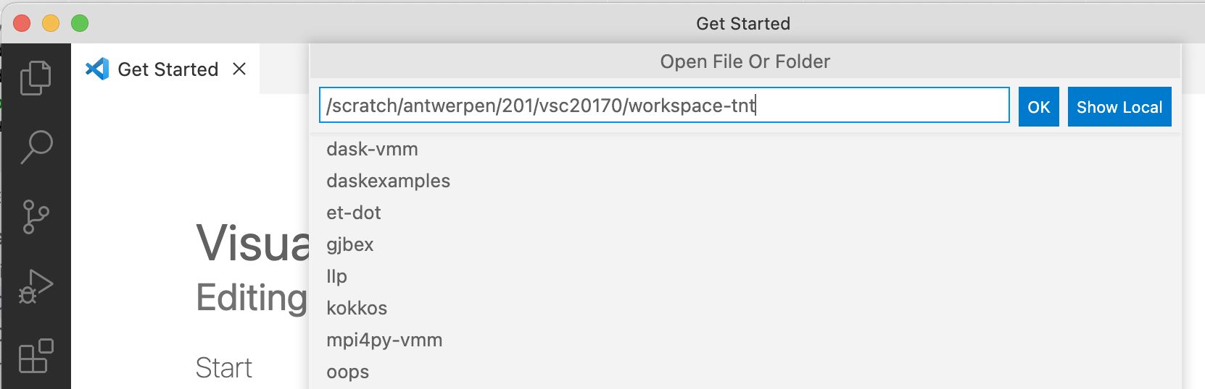
VS Code for remote work
hit OK

Slide 46
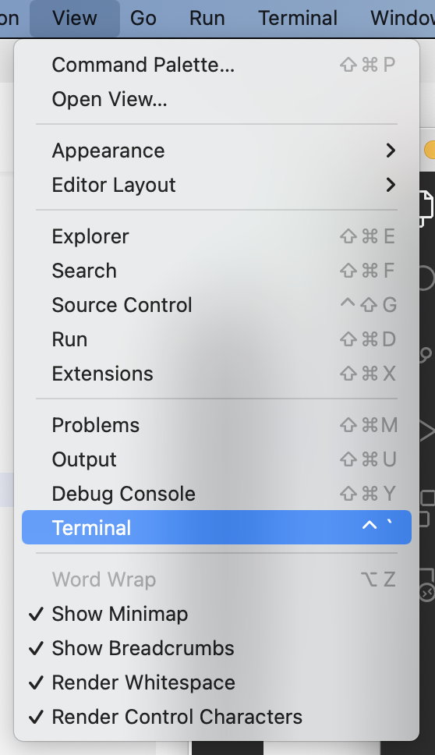
VS Code for remote work
open a terminal, using View/Terminal from the menu bar

Slide 47
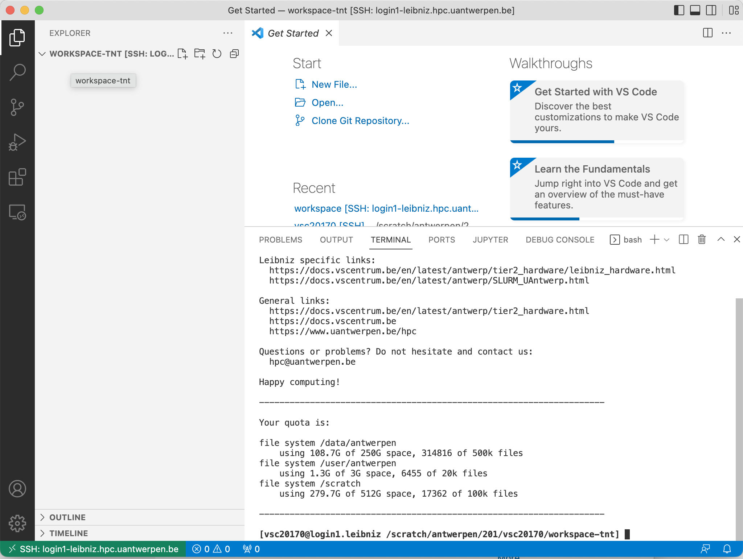
VS Code for remote work
a terminal pane is opened
Present working directory is the specified workspace

Slide 48
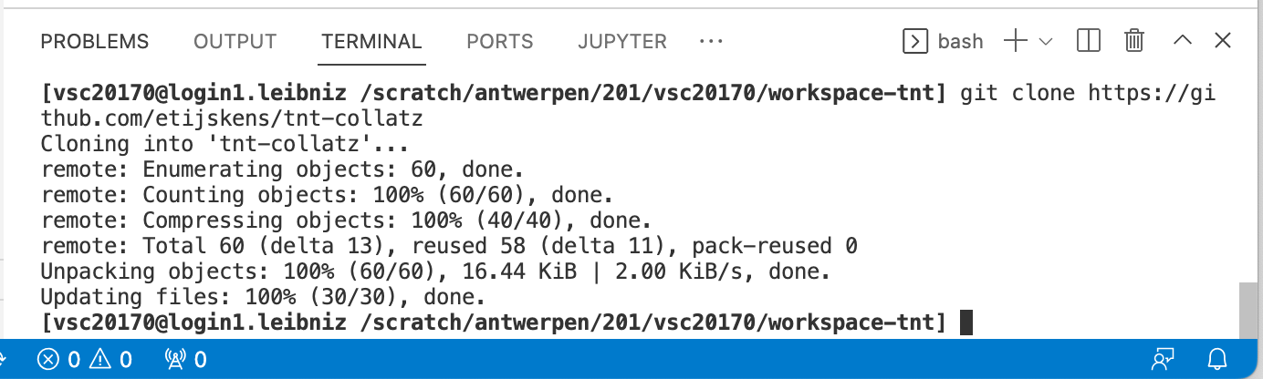
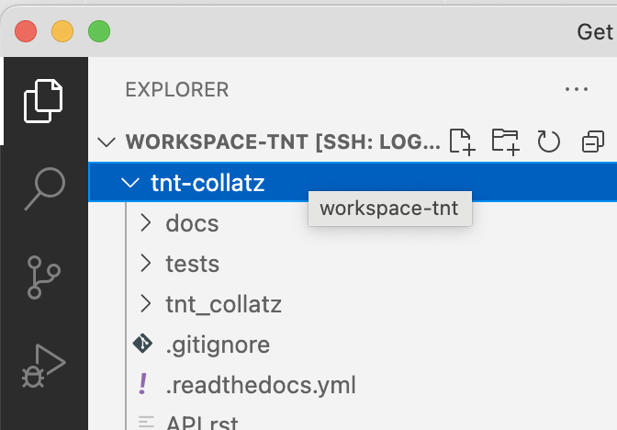
VS Code for remote work
clone the GitHub repo:
explorer view is automatically adjusted and can be expanded to see the files and directories in the repo

Slide 49
VS Code for remote work
setup your environment (in the terminal)
load LMOD modules needed
python, numba, git, buildtools, …
set environment variable PYTHONUSERBASE to control `pip install --user`
best done in a bash script env.sh specific for this project (c.q. tnt_collatz), and add it to your git repository (reproducipb
source the script everytime you open a remote terminal:
> source env.sh

Slide 50
VS Code for remote work
# file env.sh # You must source this file: `> source env.sh` # start from clean environment module purge module load $VSC_INSTITUTE_CLUSTER/supported # (this may not work on all VSC clusters, # but it does on the Uantwerpen clusters) # load modules needed for Python module load Python # also numpy, scipy, sympy, pandas, matplotlib, mpi4py, # C/C++ and Fortran compilers … module load numba module load buildtools # Cmake (needed by micc2) module load git module load gh # (needed by micc2) module list # list all loaded modules # allow to install python packages locally using `pip install --user` export PYTHONUSERBASE=/scratch/antwerpen/guest/your_guest_id/.local mkdir -p ${PYTHONUSERBASE} export PATH="$PATH:${PYTHONUSERBASE}/bin"

Slide 51
VS Code for remote work
setup your environment (in the terminal)
load LMOD modules needed
python, support for micc2, …
(install and setup micc2 the first time)
perhaps a Python virtual environment
…
e.g. https://github.com/etijskens/IIp/bin/iip-env.sh
cd into the project directory
and continue your work as before…

Slide 52
VS Code for remote work
e.g. build and test:
[vsc20170@login1.leibniz /scratch/antwerpen/201/vsc20170/workspace-tnt/tnt-collatz] micc2 build
[INFO] [ Building cpp module 'tnt_collatz/simd':
['/apps/antwerpen/broadwell/centos7/Python/3.8.3-intel-2020a/lib/python3.8/site-packages', '/scratch/antwerpen/201/vsc20170/.local/lib/python3.8/site-packages']
path_to_cmake_tools=/scratch/antwerpen/201/vsc20170/.local/lib/python3.8/site-packages/pybind11/share/cmake/pybind11
[DEBUG] [ > cmake -D PYTHON_EXECUTABLE=/apps/antwerpen/broadwell/centos7/Python/3.8.3-intel-2020a/bin/python -D pybind11_DIR=/scratch/antwerpen/201/vsc20170/.local/lib/python3.8/site-packages/pybind11/share/cmake/pybind11 ..
...
[INFO] Binary extensions built successfully:
[INFO] - /scratch/antwerpen/201/vsc20170/workspace-tnt/tnt-collatz/tnt_collatz/simd.cpython-38-x86_64-linux-gnu.so
[vsc20170@login1.leibniz /scratch/antwerpen/201/vsc20170/workspace-tnt/tnt-collatz] pytest
/apps/antwerpen/broadwell/centos8/Python/3.8.3-intel-2020a/lib/python3.8/site-packages/_pytest/terminal.py:287: PytestDeprecationWarning: TerminalReporter.writer attribute is deprecated, use TerminalReporter._tw instead at your own risk.
See https://docs.pytest.org/en/latest/deprecations.html#terminalreporter-writer for more information.
warnings.warn(
=================================== test session starts ====================================
platform linux -- Python 3.8.3, pytest-5.4.1, py-1.8.1, pluggy-0.13.1
rootdir: /scratch/antwerpen/201/vsc20170/workspace-tnt/tnt-collatz
plugins: xonsh-0.9.17.dev2
collected 2 items
tests/tnt_collatz/test_tnt_collatz.py . [ 50%]
tests/tnt_collatz/simd/test_simd.py . [100%]
==================================== 2 passed in 1.03s =====================================

Slide 53
running a script in VS Code – locally/remotely
to just run a piece of Python code, I prefer the terminal (system or VS Code terminal)
full control of the python version/environment you want
e.g. (local) using pyenv for python interpreter control:
> python --version Python 3.8.5 > pyenv local 3.10-dev > python --version Python 3.10.5+ > python my_script.py ...
e.g. (remote, on Leibniz):
> module load ...
IntelPython3/2020a, Python/3.8.3-intel-2020a, …

Slide 54
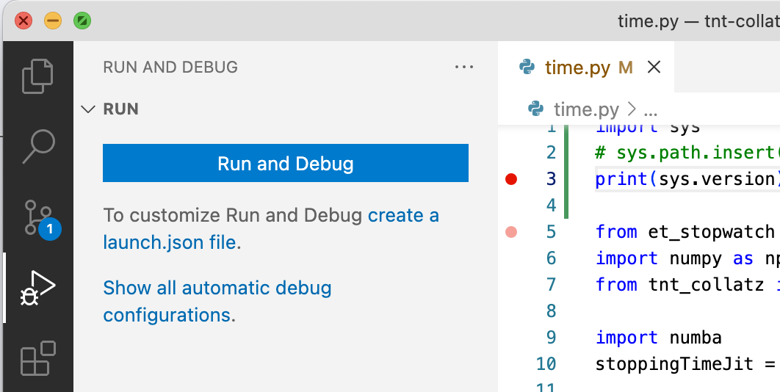
debugging a script in VS Code – locally
select the file you want to debug in the editor pane
select the RUN AND DEBUG view, and hit Run and Debug

Slide 55
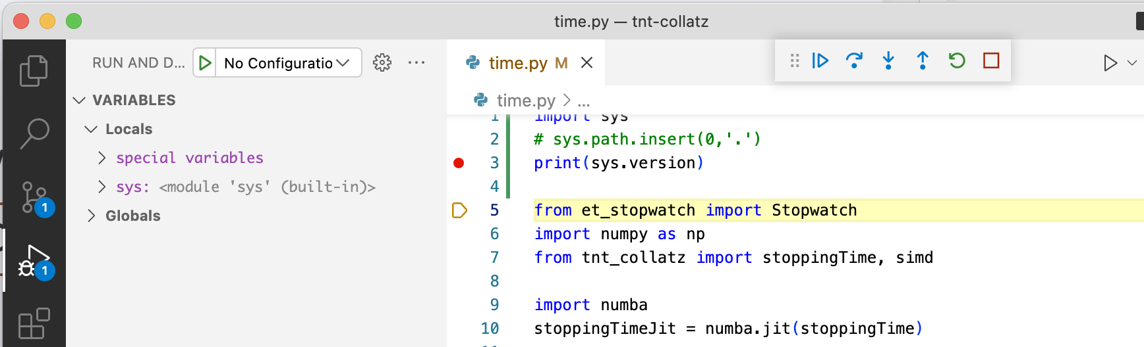
debugging a script in VS Code – locally
set a breakpoint
hit Start Debugging (F5) and use the buttons to step, continue, restart, …

Slide 56
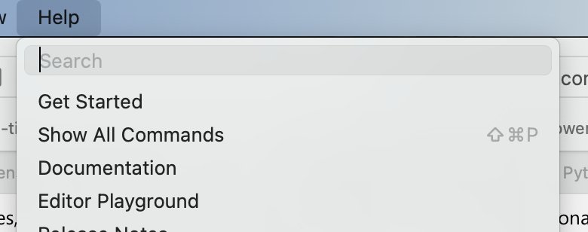
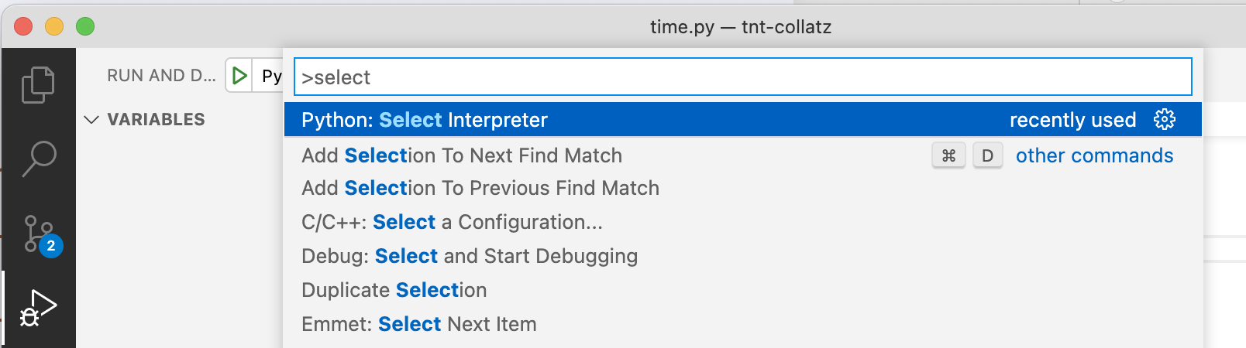
debugging a script in VS Code – locally selecting the interpreter for the debugger
in the help menu select Show All Commands
type “select” in the search field:
select “Python: Select Interpreter”

Slide 57
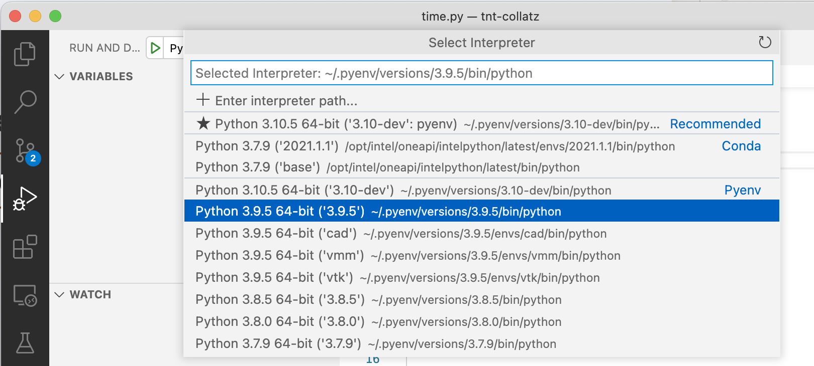
debugging a script in VS Code – locally selecting the interpreter for the debugger (continued)
select the interpreter you need:

Slide 58
debugging a Python script in VS Code – remotely
non-intuitive (to say the least), but should be possible
check out
https://stackoverflow.com/questions/73378057/how-to-debug-remote-python-script-in-vs-code
https://donjayamanne.github.io/pythonVSCodeDocs/docs/
https://learn.microsoft.com/en-us/visualstudio/python/debugging-python-code-on-remote-linux-machines?view=vs-2022
https://github.com/bulletmark/debugpy-run

Slide 59
debugging a Python script in VS Code – remotely
pdb to the rescue, debug in terminal
terminal can be local or remote
terminal can be in vscode
powerfull, but cli experience instead of gui
part of Python standard library (so always available)
check out
https://docs.python.org/3/library/pdb.html
https://realpython.com/python-debugging-pdb/

Slide 60
debugging a Python script in VS Code – remotely
start your script with pdb
> python -m pdb tests/tnt_collatz/simd/test_simd.py
> /scratch/antwerpen/201/vsc20170/tnt-collatz/tests/tnt_collatz/simd/test_simd.py(6)<module>()
-> """
(Pdb)
-> = next statement to be executed
end of the file doc-string:
“““
Tests for C++ module tnt_collatz.simd.
”””
pdb command prompt

Slide 61
debugging a Python script in VS Code – remotely
> python -m pdb tests/tnt_collatz/simd/test_simd.py
> /scratch/antwerpen/201/vsc20170/tnt-collatz/tests/tnt_collatz/simd/test_simd.py(6)<module>()
-> """
(Pdb) l
1 #!/usr/bin/env python
2 # -*- coding: utf-8 -*-
3
4 """
5 Tests for C++ module tnt_collatz.simd.
6 -> """
7
8 import sys
9 sys.path.insert(0,'.')
10
11 import numpy as np
(Pdb)
l = list source code
-> = next statement to be executed
(end of the file doc-string)
line numbers
together with VSCode editor this helps to see where you are

Slide 62
debugging a Python script in VS Code – remotely
> python -m pdb tests/tnt_collatz/simd/test_simd.py
> /scratch/antwerpen/201/vsc20170/tnt-collatz/tests/tnt_collatz/simd/test_simd.py(6)<module>()
-> """
(Pdb) l
1 #!/usr/bin/env python
2 # -*- coding: utf-8 -*-
3
4 """
5 Tests for C++ module tnt_collatz.simd.
6 -> """
7
8 import sys
9 sys.path.insert(0,'.')
10
11 import numpy as np
(Pdb) n
> /scratch/antwerpen/201/vsc20170/tnt-collatz/tests/tnt_collatz/simd/test_simd.py(8)<module>()
-> import sys
(Pdb)
n = continue execution until next statement
-> = next statement to be executed

Slide 63
debugging a Python script in VS Code – remotely
familiarize yourself with essential pdb commands

Slide 64
debugging binary extensions – locally/remotely (Linux)
combining gdb (GNU debugger) and pdb (Python debugging module)
on macOS you may want to replace gdb with lldb, but (at the time of writing) limited support for Fortran
Windows: do all your work
remotely on a VSC cluster
in a Linux terminal using WSL (Windows Subsystem for Linux)
must build binary extension with debug symbols:
> micc2 build --build-type Debug

Slide 65
debugging binary extensions – locally/remotely (Linux)
(ignoring most of the output)
> gdb python
...
> b simd.cpp:37
No source file named simd.cpp.
Make breakpoint pending on future shared library load? (y or [n]) y
Breakpoint 1 (simd.cpp:37) pending.
> run –m pdb time.py
> /scratch/antwerpen/201/vsc20170/workspace/tnt-collatz/time.py(1)<module>()
-> import sys
(Pdb) n
> /scratch/antwerpen/201/vsc20170/workspace/tnt-collatz/time.py(2)<module>()
-> print(sys.version)
(Pdb)
3.8.3 (default, Feb 18 2022, 12:54:57)
[GCC Intel(R) C++ gcc 9.3 mode]
> /scratch/antwerpen/201/vsc20170/workspace/tnt-collatz/time.py(4)<module>()
-> from et_stopwatch import Stopwatch
> b 33
Breakpoint 1 at /scratch/antwerpen/201/vsc20170/workspace/tnt-collatz/time.py:33
>
start debugging Python with gdb

Slide 66
debugging binary extensions – locally/remotely (Linux)
(ignoring most of the output)
> gdb python
...
> b simd.cpp:44
No source file named simd.cpp.
Make breakpoint pending on future shared library load? (y or [n]) y
Breakpoint 1 (simd.cpp:37) pending.
> run –m pdb time.py
> /scratch/antwerpen/201/vsc20170/workspace/tnt-collatz/time.py(1)<module>()
-> import sys
(Pdb) n
> /scratch/antwerpen/201/vsc20170/workspace/tnt-collatz/time.py(2)<module>()
-> print(sys.version)
(Pdb)
3.8.3 (default, Feb 18 2022, 12:54:57)
[GCC Intel(R) C++ gcc 9.3 mode]
> /scratch/antwerpen/201/vsc20170/workspace/tnt-collatz/time.py(4)<module>()
-> from et_stopwatch import Stopwatch
> b 33
Breakpoint 1 at /scratch/antwerpen/201/vsc20170/workspace/tnt-collatz/time.py:33
>
set a breakpoint in a source file of the binary extension
gdb will complain, since it hasn’t seen the binary extension yet

Slide 67
debugging binary extensions – locally/remotely (Linux)
(ignoring most of the output)
> gdb python
...
> b simd.cpp:44
No source file named simd.cpp.
Make breakpoint pending on future shared library load? (y or [n]) y
Breakpoint 1 (simd.cpp:44) pending.
> run –m pdb time.py
> /scratch/antwerpen/201/vsc20170/workspace/tnt-collatz/time.py(1)<module>()
-> import sys
(Pdb) n
> /scratch/antwerpen/201/vsc20170/workspace/tnt-collatz/time.py(2)<module>()
-> print(sys.version)
(Pdb)
3.8.3 (default, Feb 18 2022, 12:54:57)
[GCC Intel(R) C++ gcc 9.3 mode]
> /scratch/antwerpen/201/vsc20170/workspace/tnt-collatz/time.py(4)<module>()
-> from et_stopwatch import Stopwatch
> b 33
Breakpoint 1 at /scratch/antwerpen/201/vsc20170/workspace/tnt-collatz/time.py:33
>
answer ‘y’

Slide 68
debugging binary extensions – locally/remotely (Linux)
(ignoring most of the output)
> gdb python
...
> b simd.cpp:44
No source file named simd.cpp.
Make breakpoint pending on future shared library load? (y or [n]) y
Breakpoint 1 (simd.cpp:44) pending.
> run –m pdb time.py
> /scratch/antwerpen/201/vsc20170/workspace/tnt-collatz/time.py(1)<module>()
-> import sys
(Pdb) n
> /scratch/antwerpen/201/vsc20170/workspace/tnt-collatz/time.py(2)<module>()
-> print(sys.version)
(Pdb)
3.8.3 (default, Feb 18 2022, 12:54:57)
[GCC Intel(R) C++ gcc 9.3 mode]
> /scratch/antwerpen/201/vsc20170/workspace/tnt-collatz/time.py(4)<module>()
-> from et_stopwatch import Stopwatch
> b 33
Breakpoint 1 at /scratch/antwerpen/201/vsc20170/workspace/tnt-collatz/time.py:33
>
provide python command line arguments
‘-m pdb’ is for running the script time.py with the python debugger

Slide 69
debugging binary extensions – locally/remotely (Linux)
(ignoring most of the output)
> gdb python
...
> b simd.cpp:44
No source file named simd.cpp.
Make breakpoint pending on future shared library load? (y or [n]) y
Breakpoint 1 (simd.cpp:44) pending.
> run –m pdb time.py
> /scratch/antwerpen/201/vsc20170/workspace/tnt-collatz/time.py(1)<module>()
-> import sys
(Pdb) n
> /scratch/antwerpen/201/vsc20170/workspace/tnt-collatz/time.py(2)<module>()
-> print(sys.version)
(Pdb)
3.8.3 (default, Feb 18 2022, 12:54:57)
[GCC Intel(R) C++ gcc 9.3 mode]
> /scratch/antwerpen/201/vsc20170/workspace/tnt-collatz/time.py(4)<module>()
-> from et_stopwatch import Stopwatch
> b 33
Breakpoint 1 at /scratch/antwerpen/201/vsc20170/workspace/tnt-collatz/time.py:33
>
pdb halts on line 1 of time.py
showing the path of the file, current line number, the content of that line ‘->’ and the ‘(pdb)’ prompt

Slide 70
debugging binary extensions – locally/remotely (Linux)
(ignoring most of the output)
> gdb python
...
> b simd.cpp:44
No source file named simd.cpp.
Make breakpoint pending on future shared library load? (y or [n]) y
Breakpoint 1 (simd.cpp:44) pending.
> run –m pdb time.py
> /scratch/antwerpen/201/vsc20170/workspace/tnt-collatz/time.py(1)<module>()
-> import sys
(Pdb) n
> /scratch/antwerpen/201/vsc20170/workspace/tnt-collatz/time.py(2)<module>()
-> print(sys.version)
(Pdb) n
3.8.3 (default, Feb 18 2022, 12:54:57)
[GCC Intel(R) C++ gcc 9.3 mode]
> /scratch/antwerpen/201/vsc20170/workspace/tnt-collatz/time.py(4)<module>()
-> from et_stopwatch import Stopwatch
> b 33
Breakpoint 1 at /scratch/antwerpen/201/vsc20170/workspace/tnt-collatz/time.py:33
>
execute the statement and show the next statement (gdb next command)

Slide 71
debugging binary extensions – locally/remotely (Linux)
(ignoring most of the output)
> gdb python
...
> b simd.cpp:44
No source file named simd.cpp.
Make breakpoint pending on future shared library load? (y or [n]) y
Breakpoint 1 (simd.cpp:44) pending.
> run –m pdb time.py
> /scratch/antwerpen/201/vsc20170/workspace/tnt-collatz/time.py(1)<module>()
-> import sys
(Pdb) n
> /scratch/antwerpen/201/vsc20170/workspace/tnt-collatz/time.py(2)<module>()
-> print(sys.version)
(Pdb) n
3.8.3 (default, Feb 18 2022, 12:54:57)
[GCC Intel(R) C++ gcc 9.3 mode]
> /scratch/antwerpen/201/vsc20170/workspace/tnt-collatz/time.py(4)<module>()
-> from et_stopwatch import Stopwatch
> b 33
Breakpoint 1 at /scratch/antwerpen/201/vsc20170/workspace/tnt-collatz/time.py:33
>
the print statement produces some output

Slide 72
debugging binary extensions – locally/remotely (Linux)
...
> /scratch/antwerpen/201/vsc20170/workspace/tnt-collatz/time.py(4)<module>()
-> from et_stopwatch import Stopwatch
> b 34
Breakpoint 1 at /scratch/antwerpen/201/vsc20170/workspace/tnt-collatz/time.py:34
>(Pdb) c
stoppingTime : 38.182422 s
build stoppingTimeJit : 18.145487 s
stoppingTimeJit : 78.228365 s
(Pdb) n
> /scratch/antwerpen/201/vsc20170/workspace/tnt-collatz/time.py(34)<module>()
-> simd.stoppingTime(n, st)
(Pdb)
Breakpoint 1, stoppingTime (n_=..., st_=<error reading variable: Cannot access memory at address 0x5>)
at /scratch/antwerpen/201/vsc20170/workspace/tnt-collatz/tnt_collatz/simd/simd.cpp:56
56 xv[i] = ptr_n[j]; // fetch a new ptr_n value
(gdb)
set a breakpoint in the current file (time.py) on the line where we will enter the binary extension

Slide 73
debugging binary extensions – locally/remotely (Linux)
...
> /scratch/antwerpen/201/vsc20170/workspace/tnt-collatz/time.py(4)<module>()
-> from et_stopwatch import Stopwatch
> b 34
Breakpoint 1 at /scratch/antwerpen/201/vsc20170/workspace/tnt-collatz/time.py:34
>(Pdb) c
...
range: [200010, 300010[
stoppingTime : 7.157436 s
build stoppingTimeJit : 15.767008 s
stoppingTimeJit : 0.659163 s
> /scratch/antwerpen/201/vsc20170/workspace/tnt-collatz/time.py(34)<module>()
-> simd.stoppingTime(n, st)
(Pdb) n
Breakpoint 1, stoppingTime (n_=..., st_=...) at /scratch/antwerpen/201/vsc20170/workspace/tnt-collatz/tnt_collatz/simd/simd.cpp:44
44 while( !done )
(gdb) print done
$1 = false
(gdb)
continue until next breakpoint
the script produces some output
the timings are much larger, due to the debugging
now we are stepping into the binary extension, where a gdb breakpoint at line 44 will be hit
examine content of variables using print statements

Slide 74
debugging binary extensions – locally (windows)
There is a VS Code extension Python C++ Debugger
requires your binary extensions be built with Microsoft C++ compiler as well as the Microsoft Python distribution
https://marketplace.visualstudio.com/items?itemName=benjamin-simmonds.pythoncpp-debug

Slide 75
¿questions?
engelbert.tijskens@uantwerpen.be

